Slide 1
Payseur Lab Meeting 7/17/19
April Peterson
Research updates

Slide 2
(starting chapter 3)
Chapter 3, Comparison of meiotic features
(sexual dimorphism / evolution patterns)
(Chrm agnostic / short and long bins)
SC length, CO position, interference
Start analysis on males from Musc strains PWD and KAZ
(driven by initial MLH1 pattern 30%)
PWD
MSM
KAZ
Notes:
30 vs 23
Aim 3 examine patterns for CO number and position
Background
-meiotic features (how does this connect to hetC)
PWD and KAZ male patterns (connect back to HetC)
Canonical male and female landscapesA
Predictions, for ‘landscape’ differences given the MLH1 differences

Slide 3
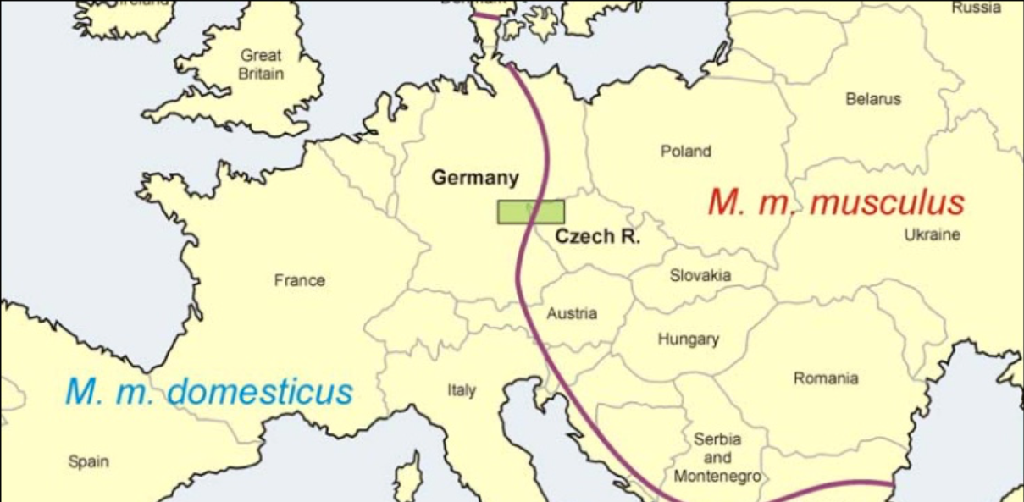
Sampling of M. m. musculus
SKIVE
KAZ
CZECH II
PWD, PWK
https://natureecoevocommunity.nature.com/users/112451-jiri-forejt/posts/33713-chromosomal-reproductive-isolation-revisited
Notes:
Point – state emphazie that looking at disparate Musc strains will be exciting / useful
(connection to evolution of Rec / HetZ) (broaden samples of Musc)
Most studied musc strains are from very close to hybrid zone
(my initial results indicate CZECHII does not have as high a RR
We got – eastern Eurasian musculus, (KAZ is actively breeding now)
Also there is a strain from Denmark – musc nuclear background and Domesticus mitochondria (apparently happened naturally)
SKIVE is a natural conplastic strain combining aM. domesticus mitochondrial genome and a M. musculus nuclear genome. Wild-derived mice are genetically distinct from common laboratory mice for a number of complex phenotypic characteristics and are valuable tools for genetic mapping, evolution and systematics research.

Slide 4
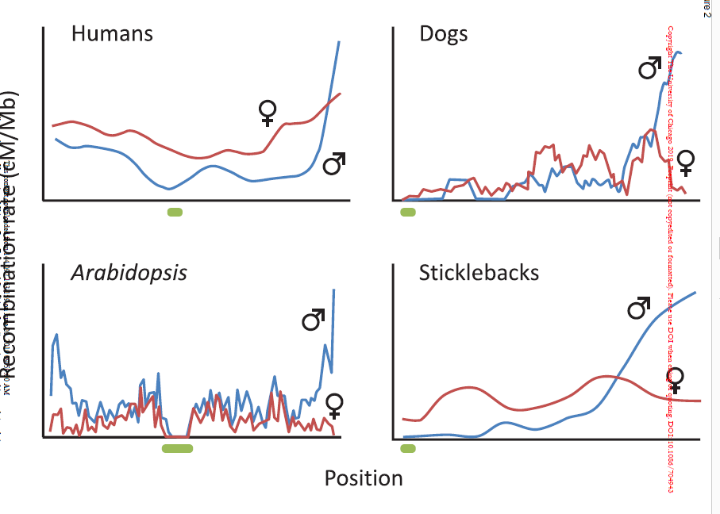
Male-specific Rec Landscape drives evolution
Bivalent level patterns are sexually dimorphimic
SACE model; Sexually Anatongistic Cis Epistasis – SA interractions between promotor and genes
Alternative functional models:
Pairing during bouquet (first CO placement)
Balance across metaphase spidle
Sardell and Kirkpatrick, 2019, American Naturalist
Notes:
Goal
Review male landscape
-- applies across all chromsomes in genome,

Slide 5
Feature | Prediction (based on MLH1 count) | Justification / model | Total Biv Pool vs Bins | Novelty
SC Length | Longer in PWD | Chromosome Axis is DSB / CO area
Chrm Classes (1CO, 2CO) | More 2COs in PWD | gwRR = sum of chromosomes | (SC ~ CO number) | NA
InterFocal Distance (IFD) (Interference) | Shorter IFD in PWD (weaker inference) | (interference) | (IFD could vary across bivalent lengths)
CO Position 1CO 2CO | No evolution / no difference | ? (interference / regional bias) ? | Yes, shorter chrms will be closer to uniform
Telomere bias, Centromere suppression | PWD has weaker centromere suppression stronger
Notes:
Review the initial predictions across traits
Careful not to make too busy
Assumptions
-no chromosome specific effects
-MLH1 is main pathway

Slide 6
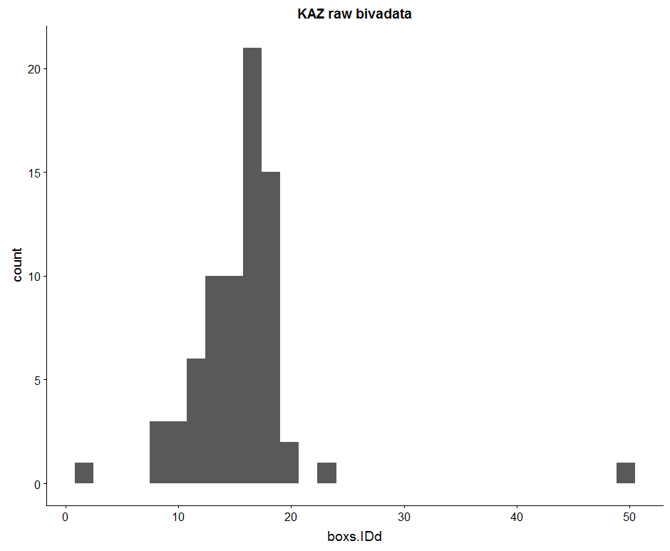
Curation of Auto Bivalent Data
19 autosomes per cell
Curated Auto.dataset | PWD | KAZ
Mice (7-12 weeks) | 4 | 3
Cells | 64 | 73
Auto-Bivalents (Total Expected, 19*73) | 542 (1216) | 740 (1387)
(+hand measures)
(N.cells with all bivs)
Bivalents ID’d per cell
Notes:
Goal
In the automated data, most cells are missing some bivalent measures. Expected bivalents measures is 19 (all autosomes)
Without 19 biv measures per cell, can’t use the rank to separate bivalents
So, making more manual measures of bivalents which were skipped by the automated
(go into process of manual measures?)

Slide 7
results

Slide 8
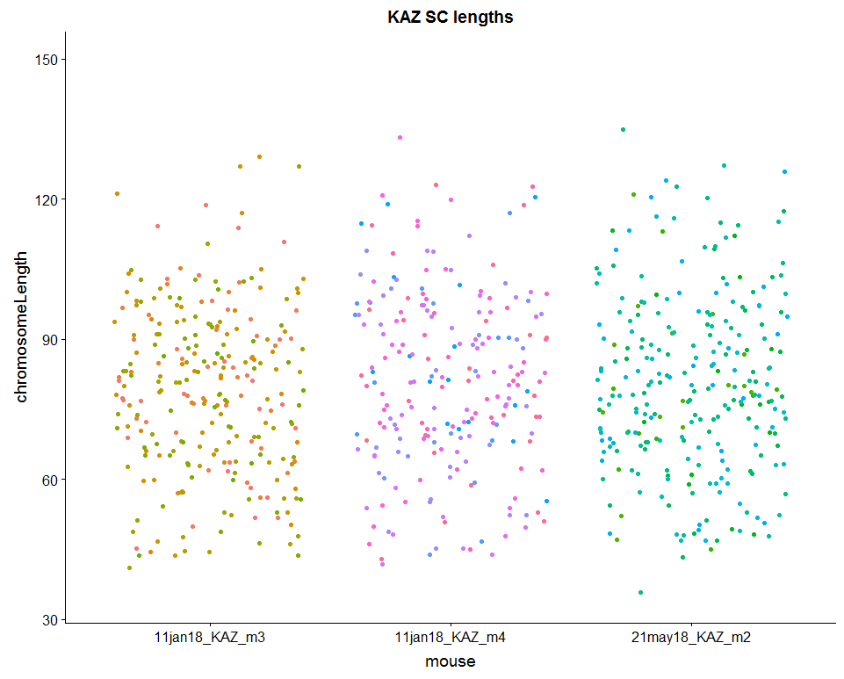
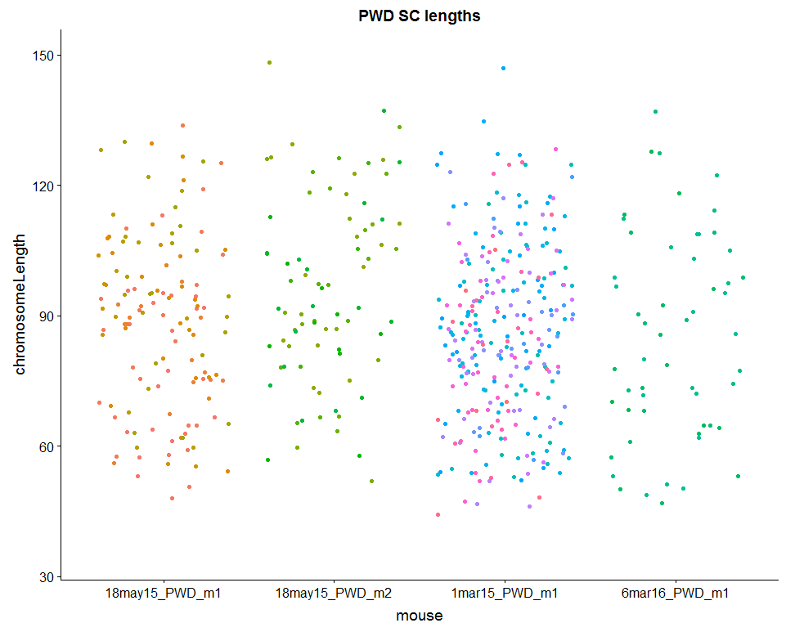
PWD have longer SC lengths
KAZ pooled bivalents
PWD pooled bivalents
78.86 80.99 80.2
88.3 95.75 86.19 84.96
Notes:
(add mean bars, to show that the average
ADD values)
Make a list of young PWD to run through Cyverse again
t.Test of all observations
p-value = 2.285e-12

Slide 9
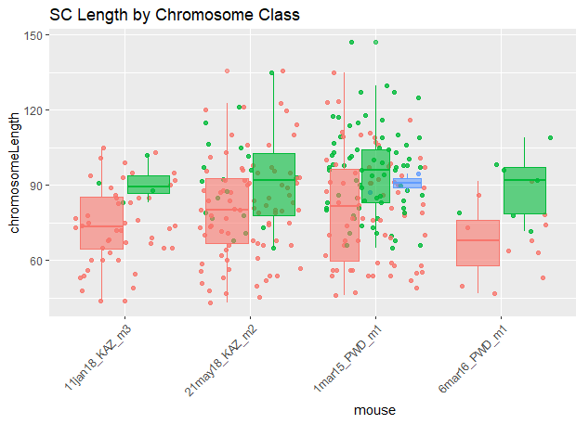
<?PWD have longer SC lengths>?
All SC | p-value = 2.285e-12
Shortest bin | 0.02131
Longest bin | 0.01495
KAZ
PWD
#p-value =
Notes:
Are PWD 2COs longer than KAZ 2COS?
Most all 2COs are longer than 1COs
There is some overlap
Kaz means 78.86 80.99 80.2
PWD means 88.3 95.75 86.19 84.96

Slide 10
PWD have more 2COs
All data | PWD | KAZ
1CO | 93 | 178
2CO | 83 | 25
3CO | 2 | 1
Whole cells | PWD | KAZ
1CO | 88 | 132
2CO | 91 | 24
3CO | 2

Slide 11
Interference, Interfocal Distances
Raw Interfocal Distance (IFD) can be similar and normalized is different. (rbar values would be different, telomere/centromere bias might be different)
noting the normalized IFD accounts for differences between different sized chromosomes.
Notes:
(review difference between nrm and

Slide 12
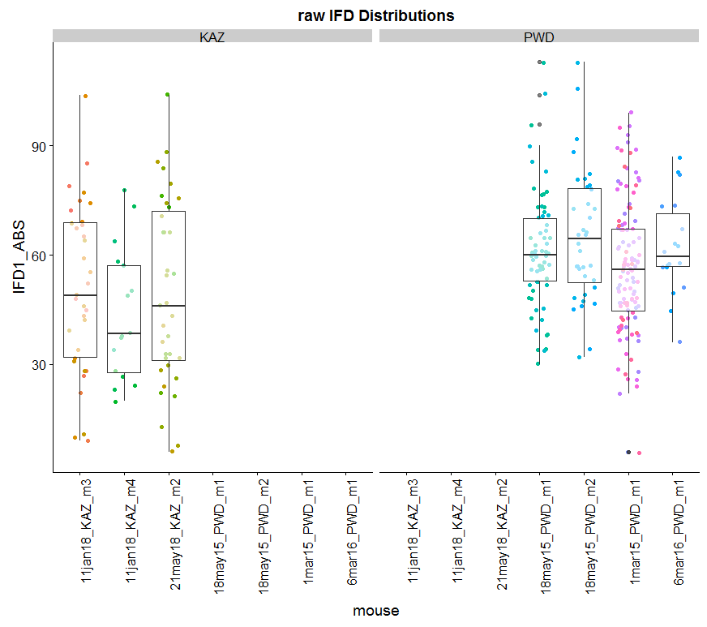
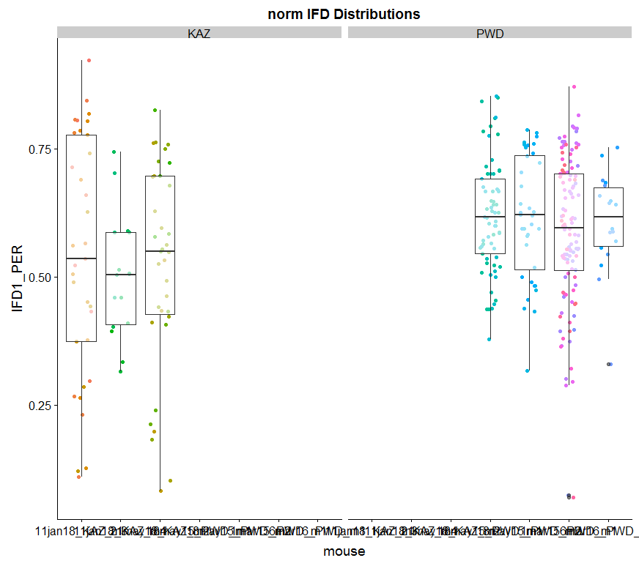
PWD have longer IFD
KAZ
PWD
KAZ
PWD
Notes:
KAZ the average IFD distance is 50% of bivalent
PWD the average IFD is ~60%
How much of an effect does subsampling have
What are the pvalues for these

Slide 13
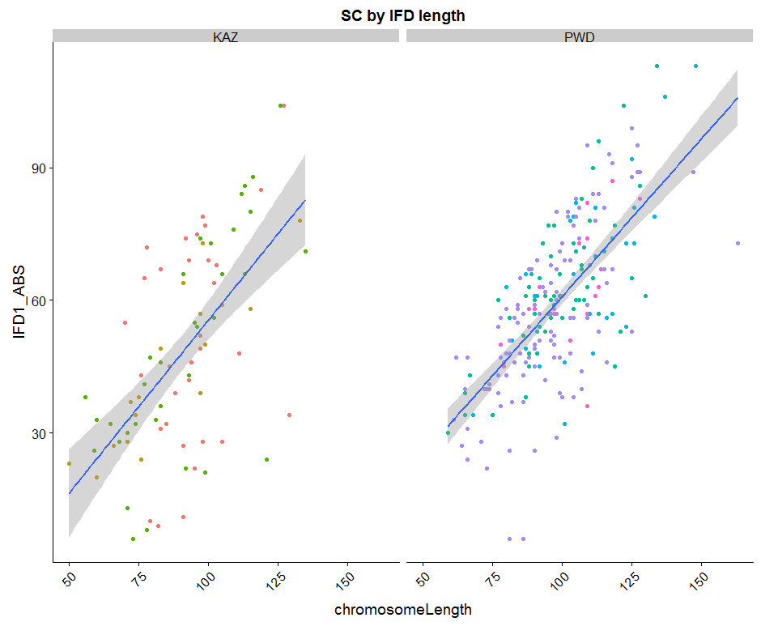
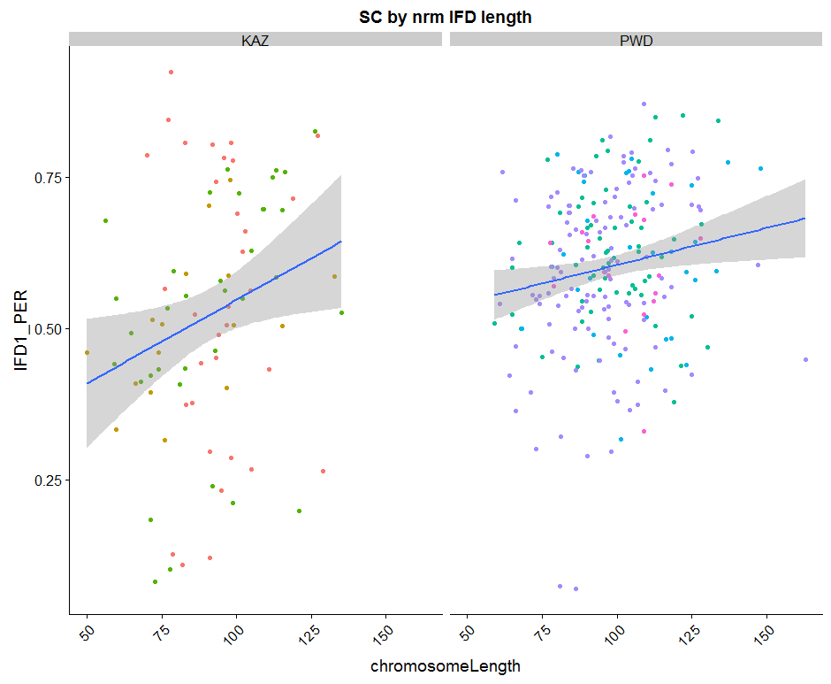
SC Length by IFD
KAZ
PWD
KAZ
PWD
Notes:
The ranges of normalized IFDs is smaller
Weak slope for IFD.PER and SC length in PWD indicates weaker SC ~ IFD.PER relationship. No matter what the length of Biv in PWD, IFD will be arounf the mean
Stronger slope for KAZ indicates that shorter bivs have shorter nrm IFDs, and longer bivalents have longer nrmIFDs.
The range for the PER/nrm is larger in KAZ,
Larger variance for KAZ for IFDs (Stronger interference in KAZ)
nrmIFD is more consistent in PWD, and more dynamic (across bivalents) in KAZ
<try dividing up by chrm size bins>

Slide 15
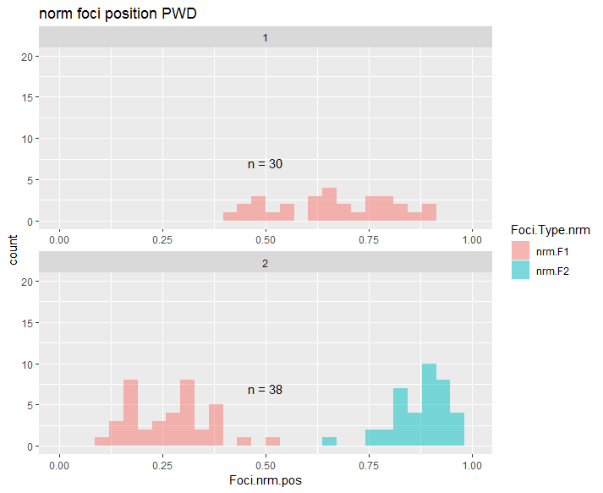
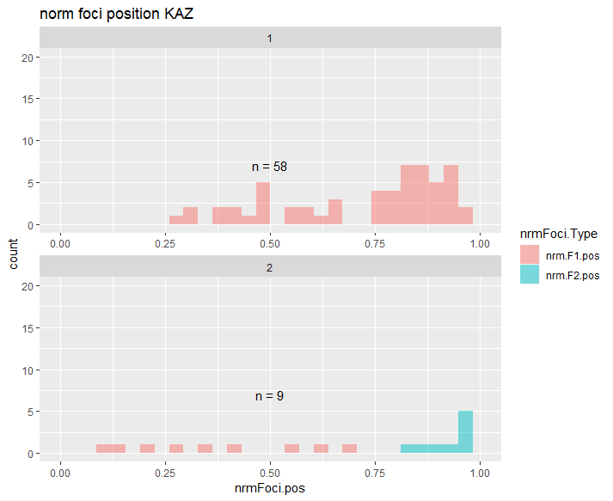
Position (not enough data?)
Notes:
Subsampled the KAZ data to a similar sample size
(PWD has longer SC)
(PWD have more 2COs)

Slide 16
Feature | Prediction (based on MLH1 count) | Justification / model | Total Biv Pool vs Bins | Supported?
SC Length | Longer in PWD | Chromosome Axis is DSB / CO area |  | Yes
Chrm Classes (1CO, 2CO) | More 2COs in PWD | gwRR = sum of chromosomes | (SC ~ CO number) | Yes
InterFocal Distance (IFD) (Interference) | Shorter IFD in PWD (weaker inference) | (interference) | (IFD could vary across bivalent lengths) | no
CO Position 1CO 2CO | No evolution / no difference | ? (interference / regional bias) ? | Yes, shorter chrms will be closer to uniform
Telomere bias, Centromere suppression | PWD has weaker centromere suppression stronger

Slide 18
Test if these are partially accurate

Slide 19
Test the correlation between single cell measures and multi-cell measures
Notes:
7feb18_11jan18_KAZ_m4_sp1_26_rev_10

Slide 20
Test if kinks affect SC length
Notes:
26jan18_11jan18_KAZ_m3_sp1_15_rev_5

Slide 21
Target mice
 | weeks | Check Biv
18may15_PWD_m1 | 7 | Y
18may15_PWD_m2 | 7 | Y
1apr16_PWD_m3 | 7.571429 | N
6mar16_PWD_m1 | 7.857143 | N
1apr16_PWD_m1 | 8.571429 | N
1apr16_PWD_m2 | 8.571429 | N
1mar15_PWD_m1 | 11.57143 | Y
 | weeks | Check Biv
21may18_KAZ_m2 | 7
30may18_KAZ_m1 | 8.285714
30may18_KAZ_m2 | 8.285714
30may18_KAZ_m3 | 8.285714
4dec17_KAZ_m1 | 8.857143
11jan18_KAZ_m2 | 9.714286
11jan18_KAZ_m3 | 9.714286 | Y
11jan18_KAZ_m4 | 9.714286 | Y
21may18_KAZ_m1 | 10 | Y?
11feb18_KAZ_m1 | 11
Notes:
Try to make sure I have BivData from these mice

Slide 22
Use RW’s algorithm data?

Slide 23
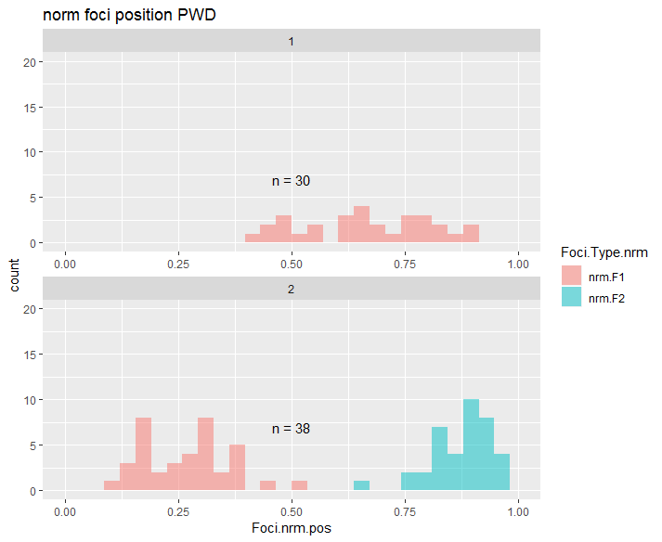
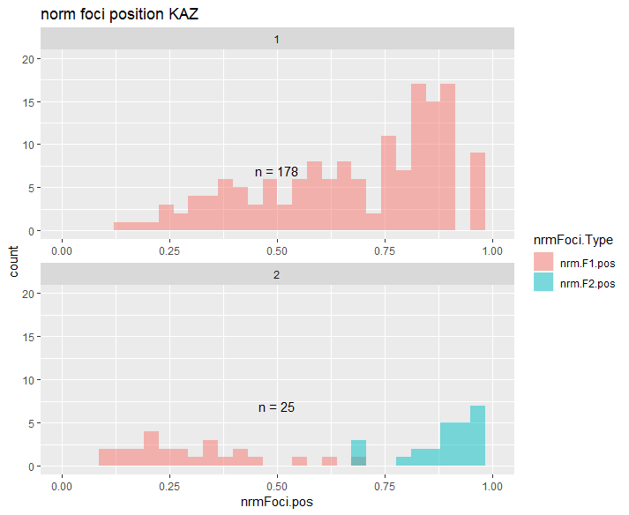
Normalized positions
Notes:
This result needs to be confirmed with more PWD data

Slide 24
Background of CO patterning
4 chromosomes, average of 8 COs per nucleus
3 phenomena of recombination positions
Obligatory CO
>1 CO per chromosome (arm)
Positive interference
Even spacing of COs
3. CO homeostasis
Nonlinear relationship between precursors and mature COs
Notes:
Example of how cells don’t look
10 COs on 4 chrms, localized on 2 chrms,
localized on 1 chrm, no spacing
Second point – even spacing across all chrms
CO spacing regulated
2) Instead what is seen are
1. even spacing
2. >1 per chrm
3. more percursors, DSBs than final CO. non linear relationship between COs and precursors
3) Three phenomena
2. 3.
Positive interference and obligatory CO thought to place a large role in the averge genome wide rate of recombination
CO homeostasis <reflects that the decision between CO and NCO acts to maintain a optimal number of COs per a cell>

Slide 25
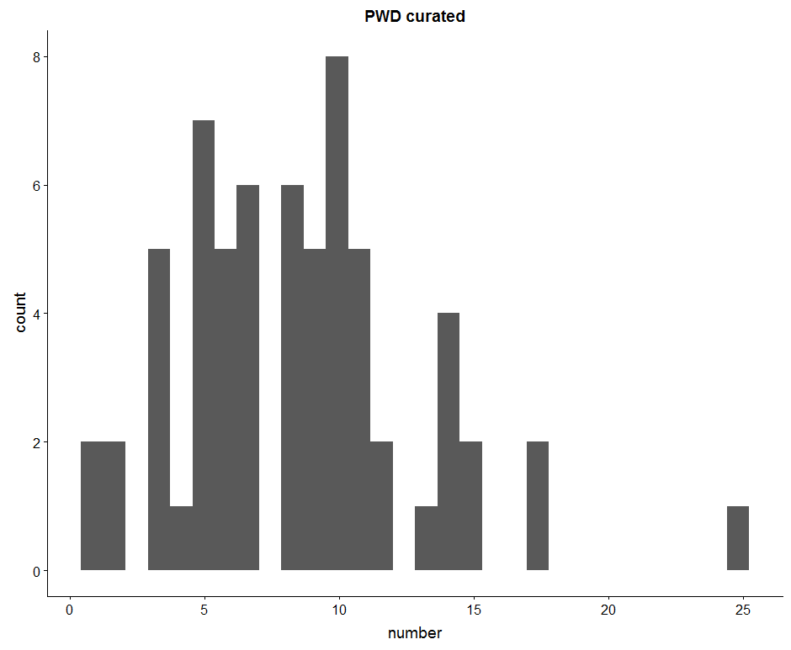
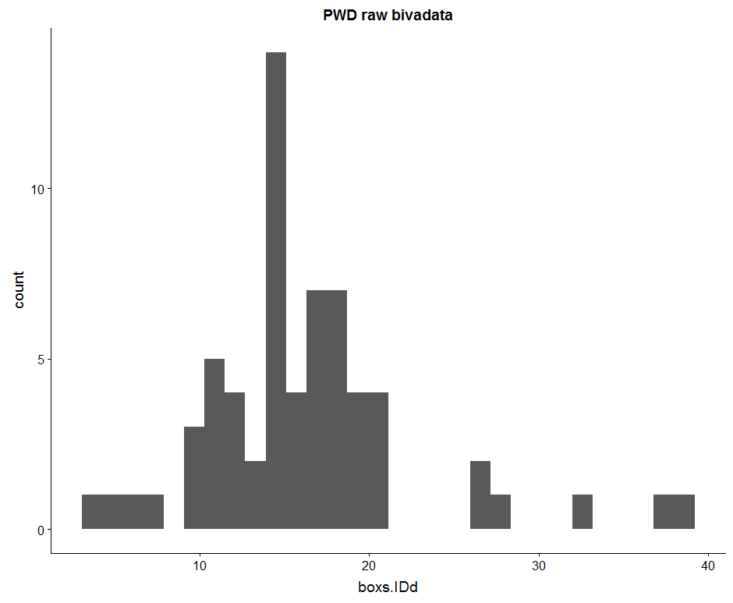

Slide 26
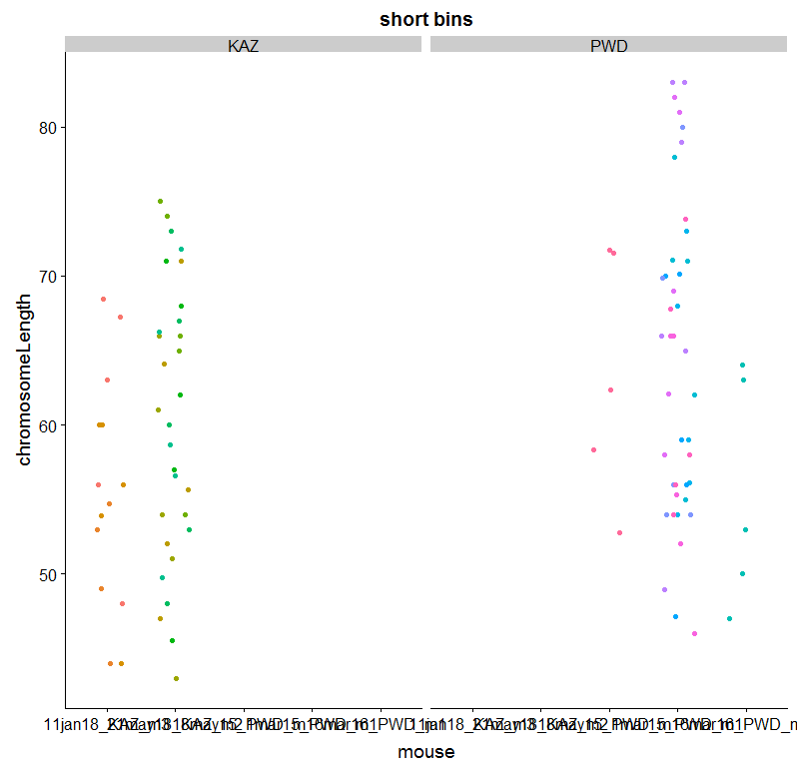

Slide 27
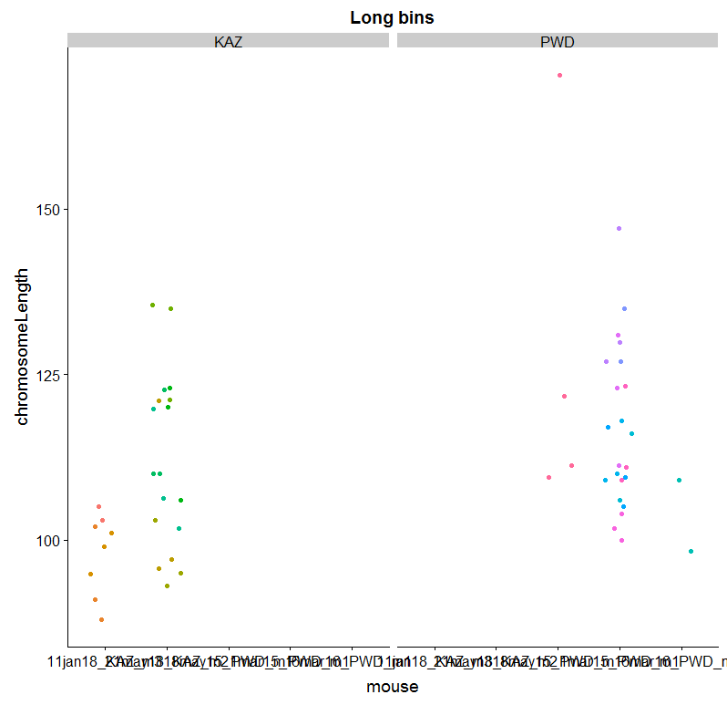
Binned, SC lengths (from each cell take the shortest and longest 5)
#p-value = 0.02131
p-value =
Notes:
(when use more comparable measures – short and long bins of bivalents
The difference is less significant)

Slide 28
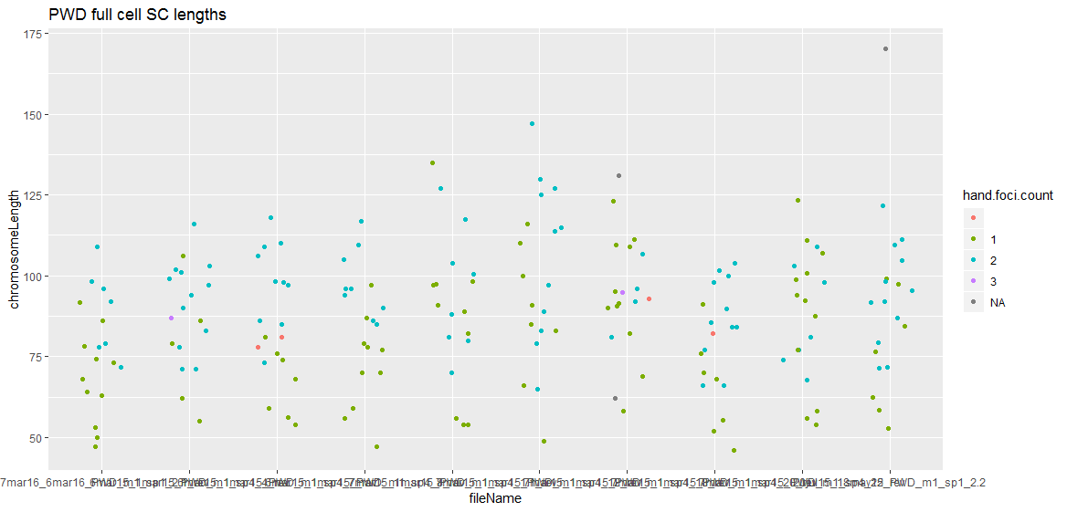
Notes:
This plot is too busy --- not sure what the point is
Within cells most

Slide 29
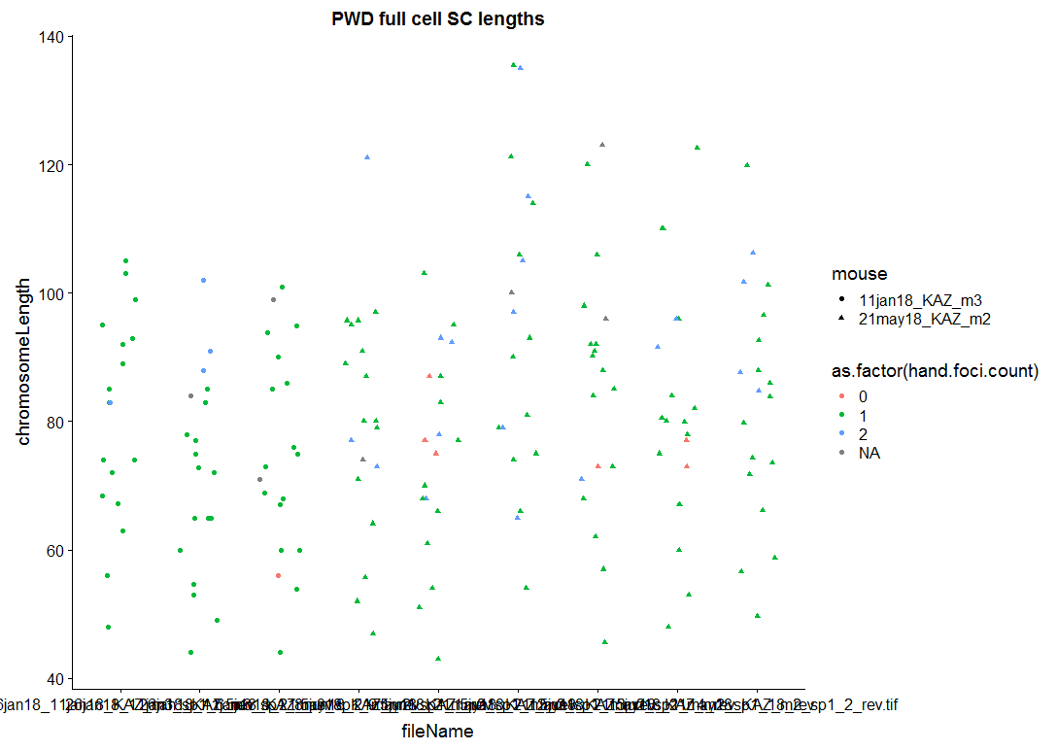

Slide 30
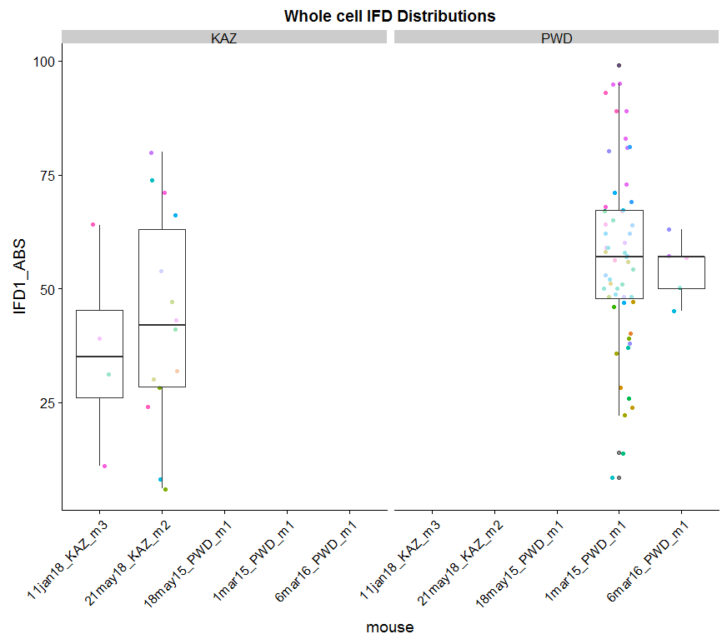
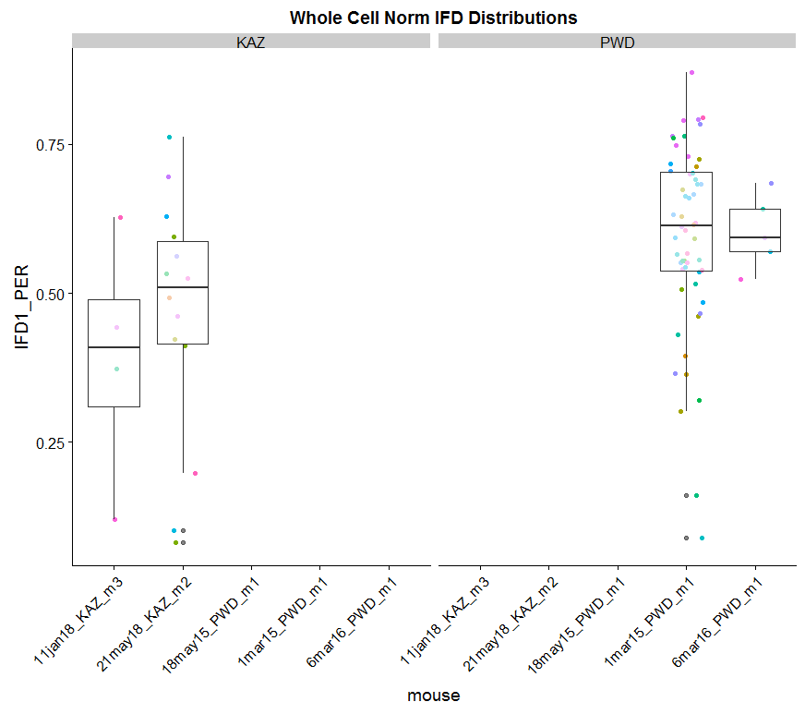
Notes:
I should just compare the 2 mice with most observations
KAZ, average IFD distance is 50% or less of total bivalent

